Slide 1
Data Management and Analysis with Python
CEU, January 2019

Slide 2
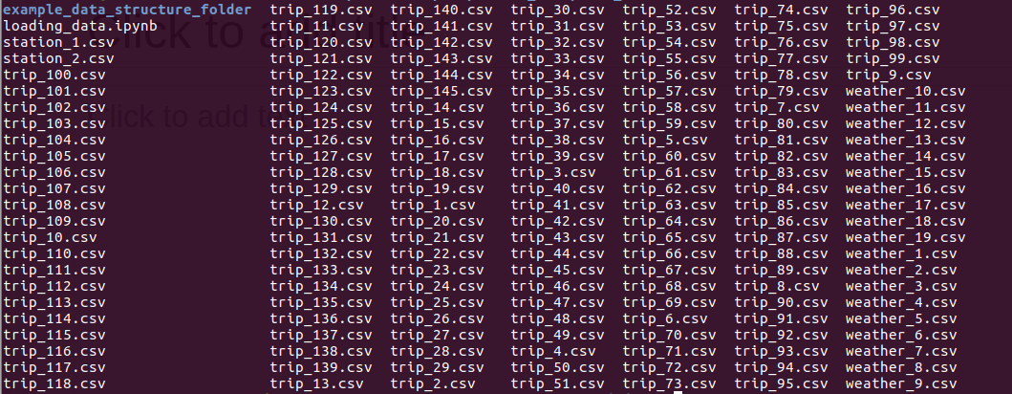
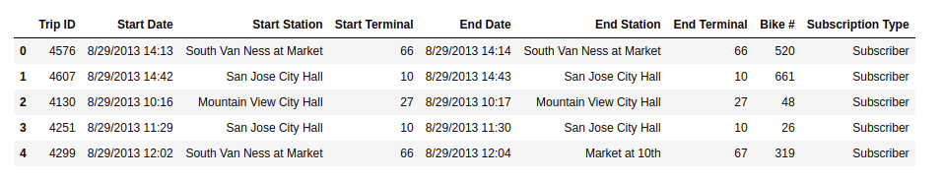
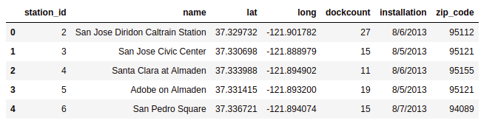
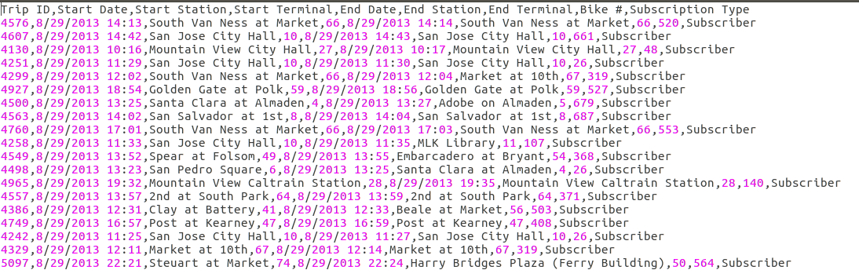
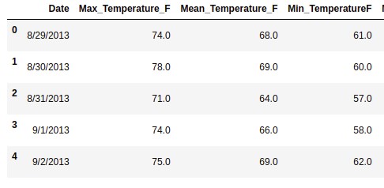
Looking at the raw data
What we have: a list of csv-files --> What we want: 3 dataframes loaded into python pandas modul

Slide 3





How we will achieve this
make a list of the filenames in the directory
['station_1.csv', 'station_2.csv', 'trip_1.csv', 'trip_2.csv', …]
create 3 empty lists fro trip/station/weather files
loop through this list and add the filename to the appropriate list

Slide 4
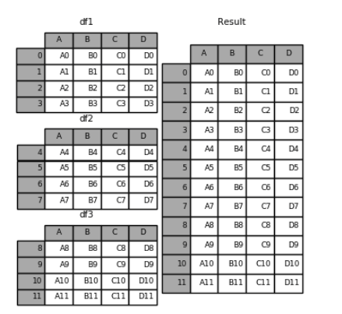
How we will achieve this
loop through the trip/station/weather lists separately and make a pandas dataframe from each csv file. Collect these dataframes into a list and concatenate them to one big dataframe.

Slide 5
Lists in python
When we have a sequence of elements we store them in a list data structure. The elements of a list can be of different types as well
List indexing starts at 0 from left and with -1 from right
colors[0] -> "red"
colors[2] -> "green"
colors[-1] -> "gray"

Slide 6
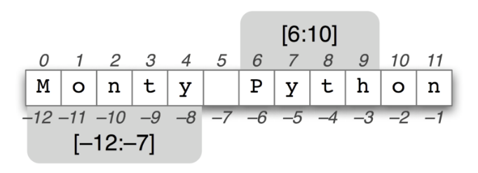
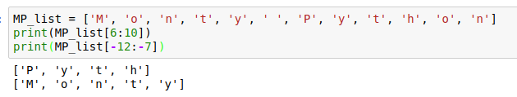
List and string slicing

Slide 7
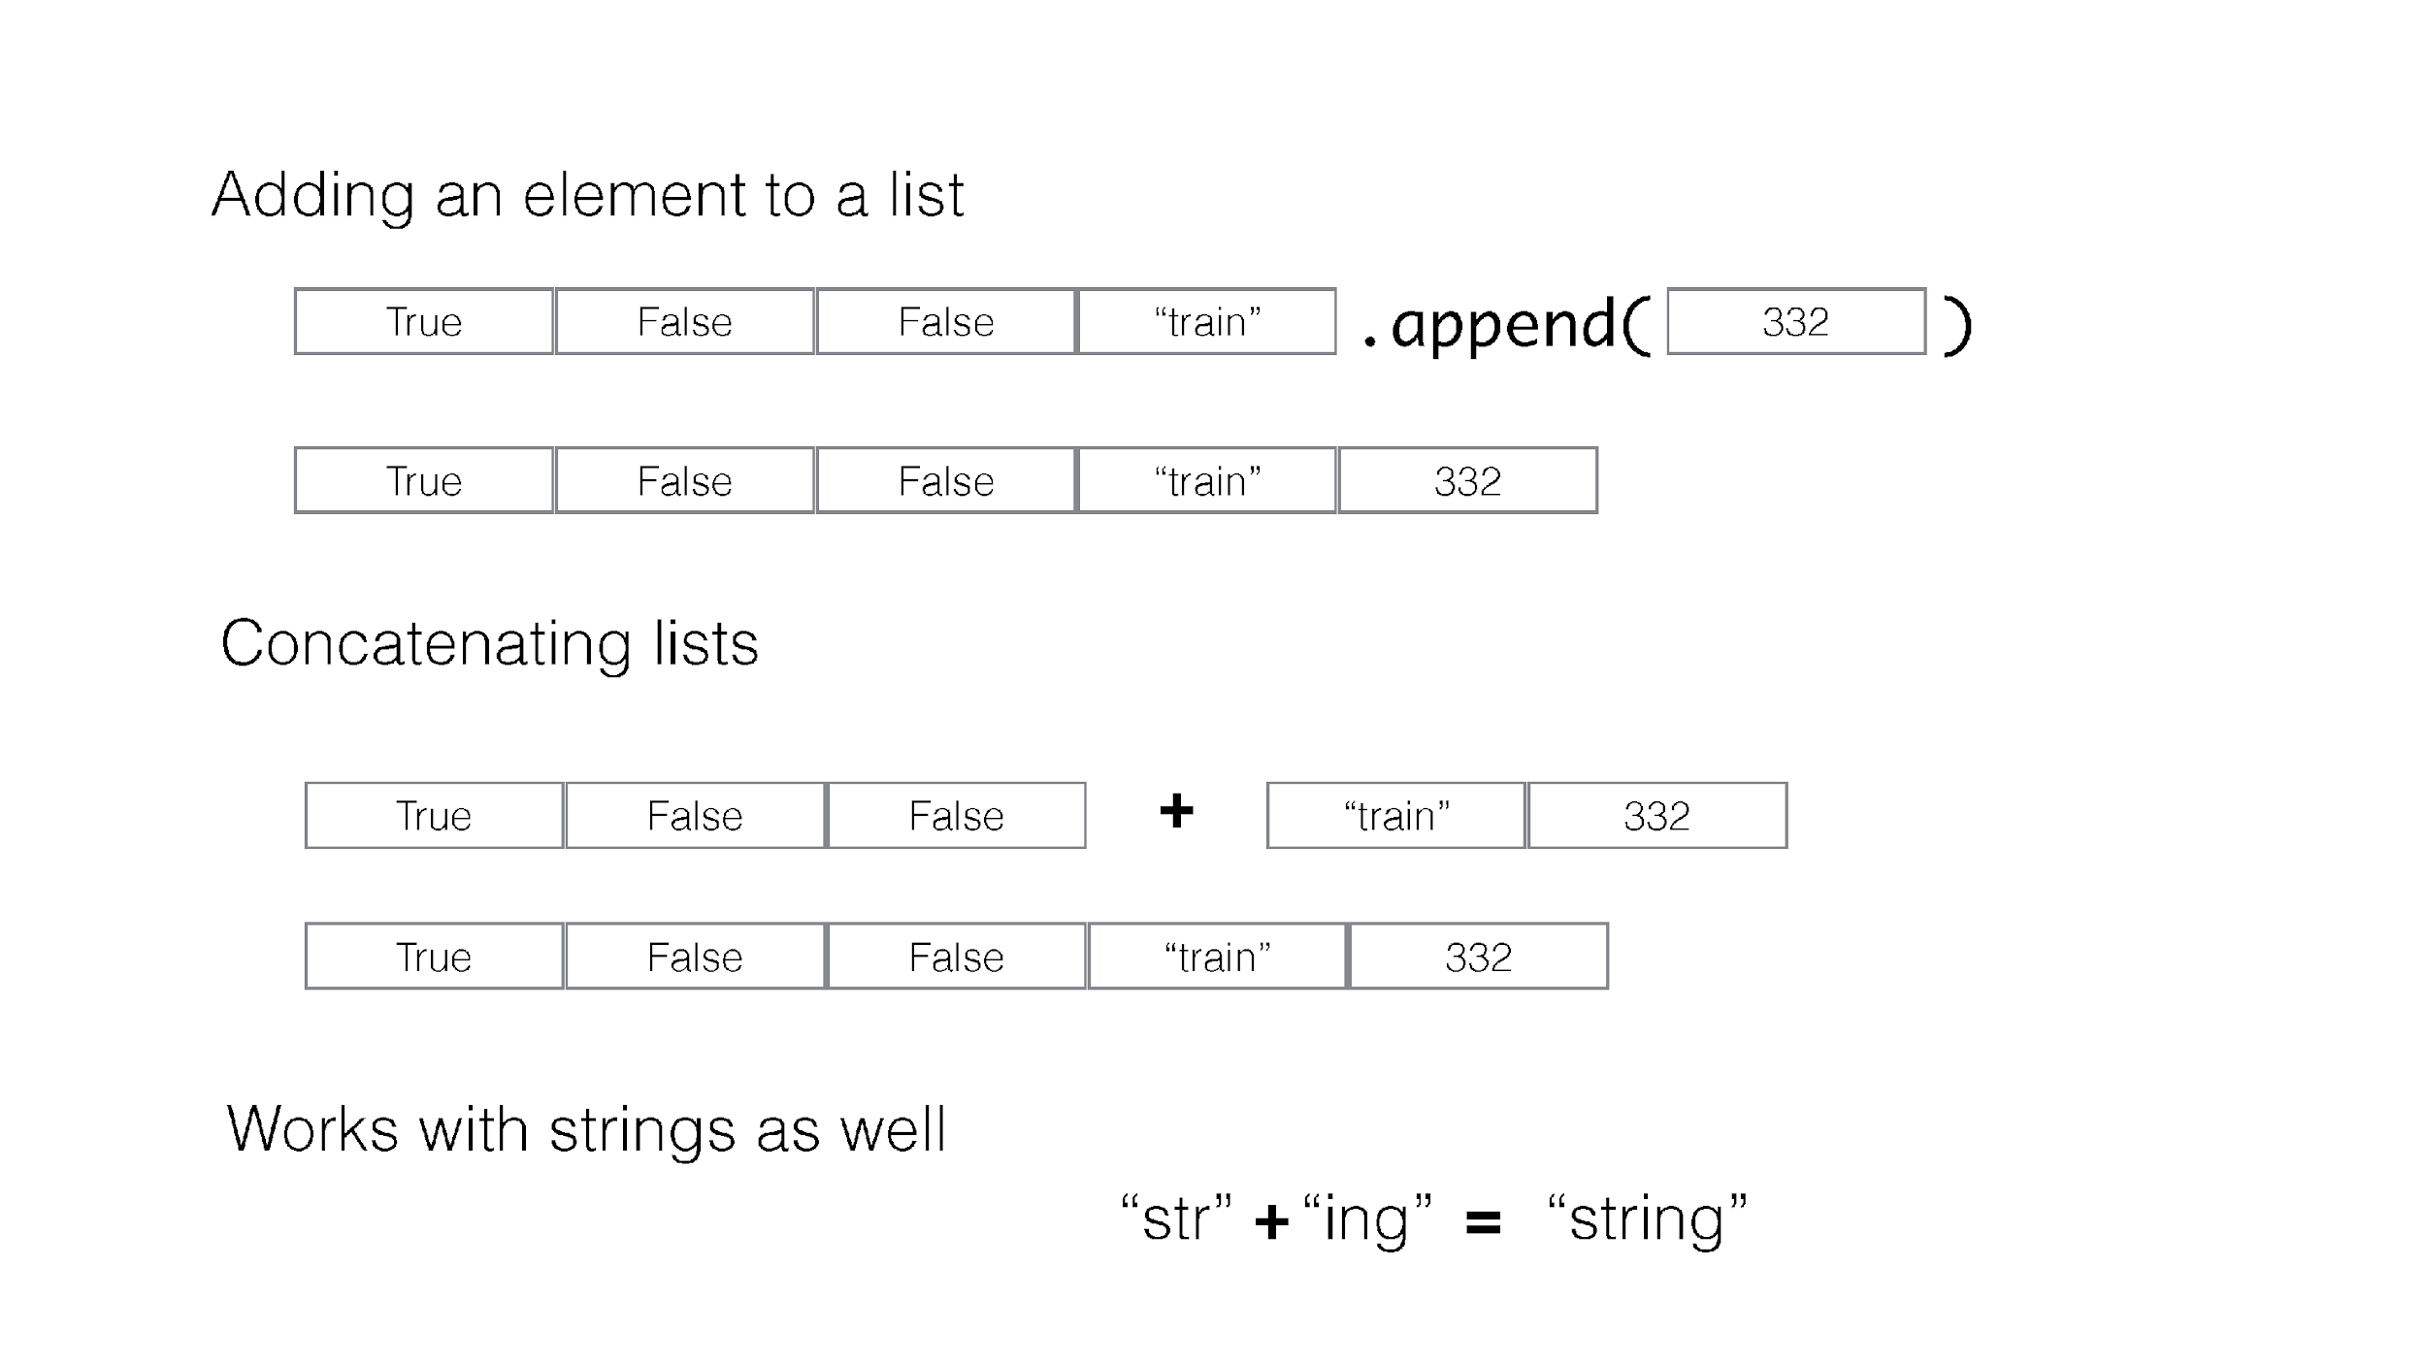

Slide 8
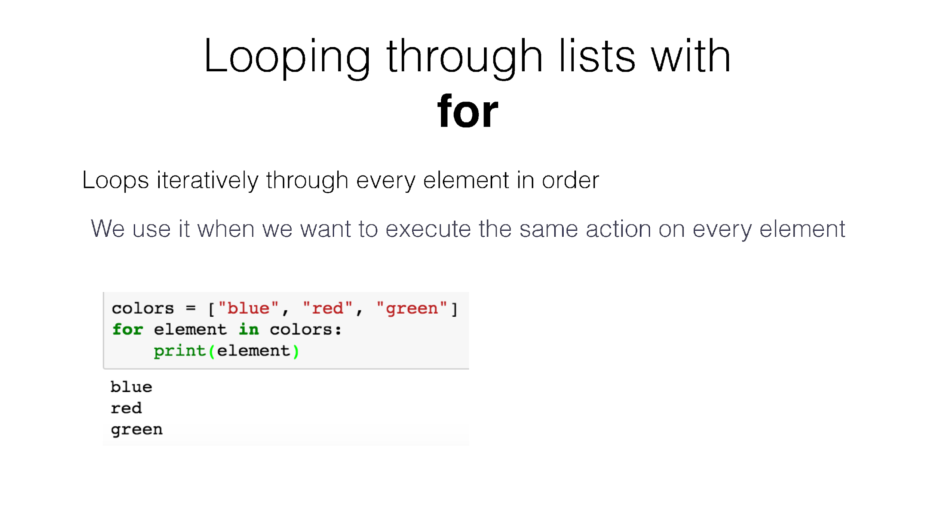

Slide 9
IF statement
Doing staff
salary = 2000
Do some extra staff
salary > 1000
salary = salary - 30
Boolean expression
True
False
Continue doing staff
print(salary)

Slide 10
IF - ELSE statement
Doing staff
salary = 2000
Do some extra staff
salary > 1000
tax = salary * 0.3
Boolean expression
True
tax = salary * 0.15
Do something else
False
Continue doing staff
salary = salary - tax

Slide 11
IF - ELIF - ELSE statement
salary = 2000
Doing staff
Do some extra staff
salary > 3000
tax = salary * 0.3
Boolean expression 1
True
False
Boolean expression 2
Do some other staff
salary > 1000
True
tax = salary * 0.15
False
Do something else
tax = 0
salary = salary - tax
Continue doing staff

